Slide 1
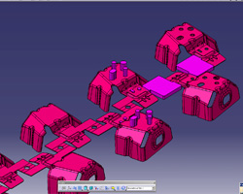
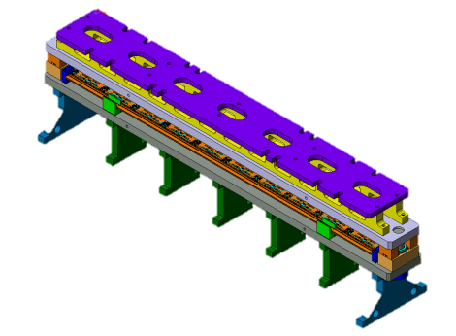
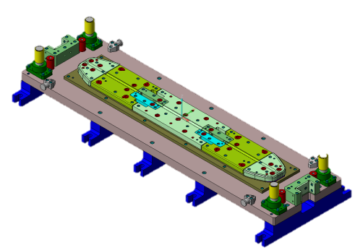
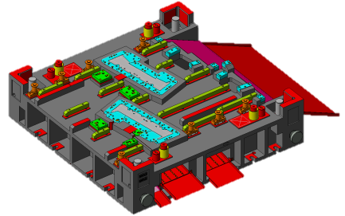
Design and simulation
Design & Simulation
Design using Visi by Vero
Features:
Full 2D and 3D Modelling
Full Analysis, Progress and Blank Design
Full 2D and 3D Machining
Simulation using Dynaform
Features:
Blank Size Engineering (BSE)
Die Evaluation
Formability Simulation
Exporting Simulation as .avi format

